Slide 1
Fire Truck Tracker
by Danny Brady

Slide 2
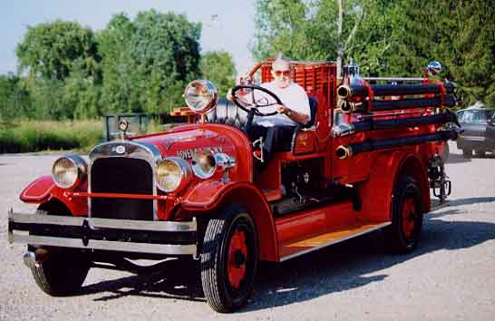
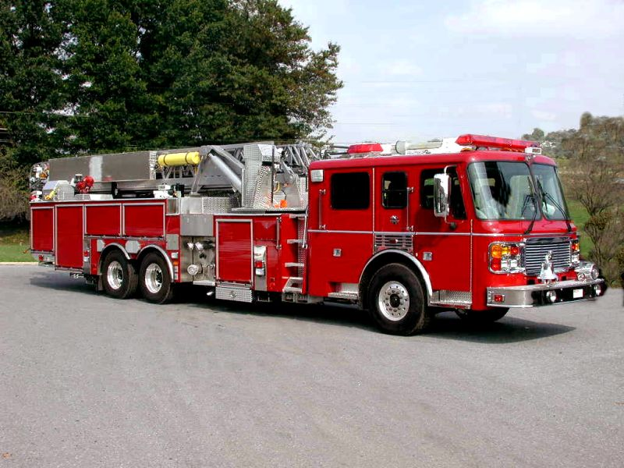
Fire Trucks Changes

Slide 3

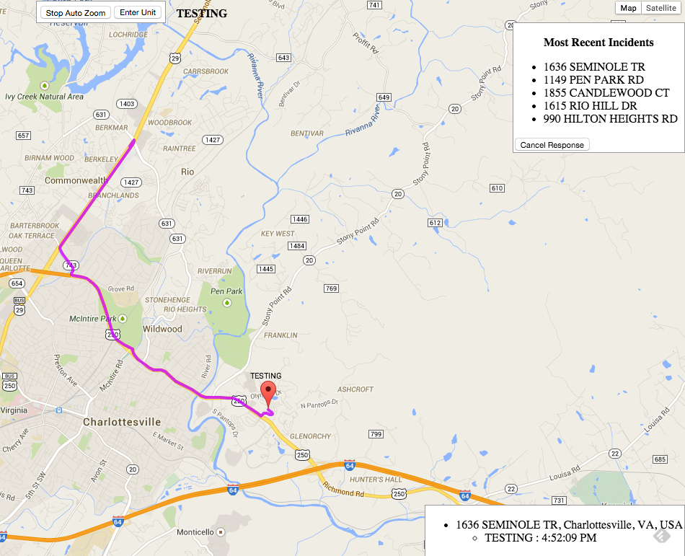
Firefighting Technology needs to change

Slide 4
The Problem With The Way It Is
Lack of situational awareness
Don’t know the order of arriving units
Don’t know how long till the next unit arrives
Safety
When multiple emergency vehicles approach the same intersection at the same time accidents can happen

Slide 5
System Pieces
Server
Mobile unit with GPS and internet connection
Email incident parser

Slide 6
Server
Written using NodeJS
Receives Data
GPS Data - Post Request
New Incidents - Post Request
Unit Responses - SocketIO
Calculates Directions and ETA’s
Uses Google maps api

Slide 7
Mobile Unit with GPS
Raspberry Pi
Auto-connects to Wifi
GPS USB Dongle
Python Program
Starts on boot
Reads GPS data and does smoothing
Sends Post request with data to server

Slide 8
Email Incident Parser
Python Code
Uses Google Gmail API
Runs on the server
Sends Post request to server

Slide 9
Future Work
More mobile device friendly
Perhaps a view only mode to hide some of the large panels on a small screen
Auto recalculate directions
The server could pretty easily do this on a timer or some kind
Proximity warning
Auto determine when arrived on scene

Slide 10
Time for awesome demo!

